Slide 1
HOTEL BOOKING ANALYSIS

Slide 2
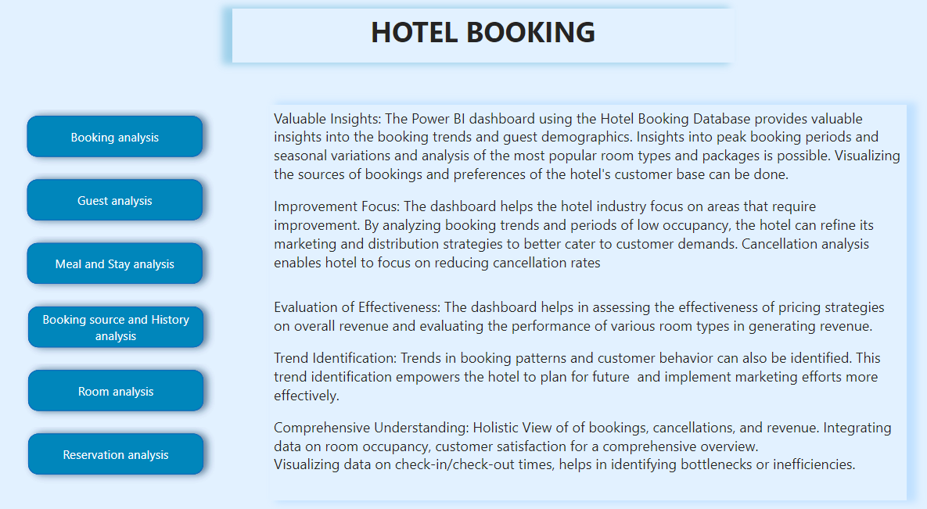

Slide 3
OBJECTIVE : The project's overarching goal is to leverage hotel booking data for actionable insights, optimizing decision-making, and enhancing guest satisfaction in the hospitality sector. The analysis will span diverse dimensions, including temporal trends, demographics, booking channels, reservation statuses, and customer types.
ANALYSIS SCOPE: The analysis encompasses a broad spectrum of factors, both quantitative and qualitative, such as seasonal trends, customer preferences for weekend vs. weekday stays, and the impact of meal plans on Average Daily Rates (ADR). The scope also extends to operational efficiency considerations, exploring correlations between special requests and ADR, as well as the allocation of room types.
SCOPE : The project's overarching goal is to leverage hotel booking data for actionable insights, optimizing decision-making, and enhancing guest satisfaction in the hospitality sector. The analysis will span diverse dimensions, including temporal trends, demographics, booking channels, reservation statuses, and customer types.

Slide 4
Insights and Recommendations: The analysis reveals opportunities to target peak booking months strategically, tailor marketing based on channels, and optimize room allocation processes. Understanding customer preferences for weekend stays and the impact of meal plans on ADR suggests avenues for personalized offerings. Addressing correlations between special requests and ADR can enhance operational efficiency, while identifying trends in reservation status dates supports proactive planning.
Report & Presentations: The project's outcomes will be presented in a concise report and visually impactful presentations. The report will outline key insights, methodologies, and actionable recommendations. Visual aids like charts and graphs will be used in presentations to communicate trends and strategic implications effectively. This approach aims to provide stakeholders with a clear understanding for informed decision-making and strategic planning.
The Power BI dashboard, in tandem with the comprehensive report and presentation, will serve as a potent tool for the hotel management and stakeholders. This resource equips them to make data-driven decisions, optimize booking strategies, foster tailored marketing approaches, and enhance overall business performance in the competitive hospitality sector.

Slide 5
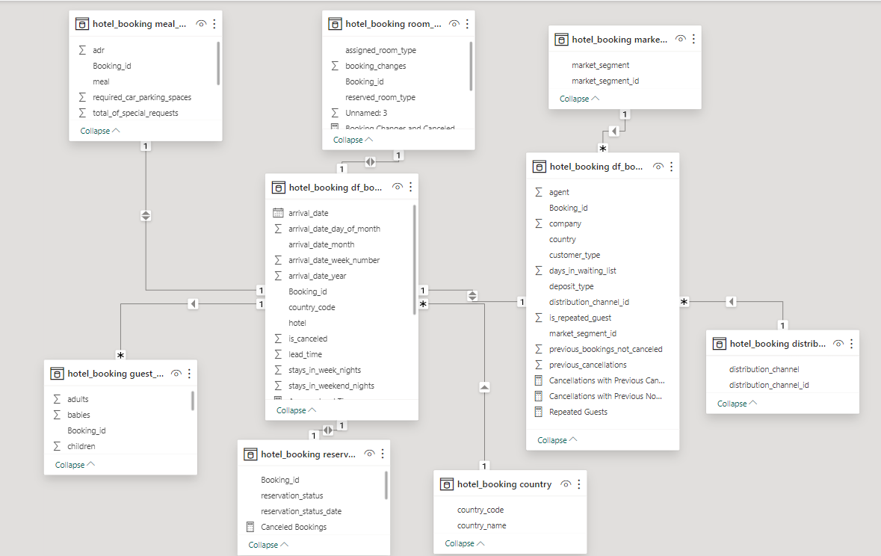

Slide 6
POWER BI PROBLEM STATEMENTS

Slide 7
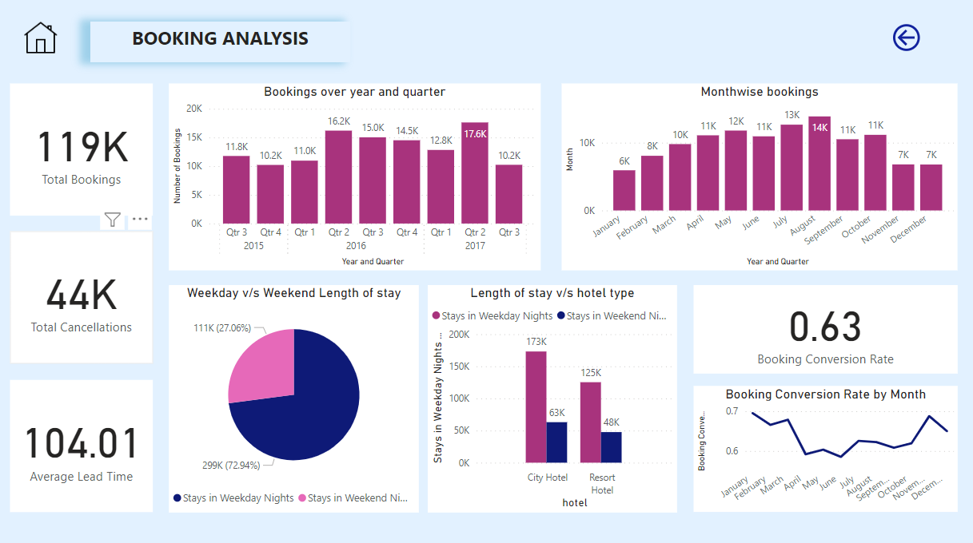

Slide 8
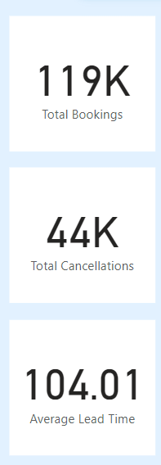
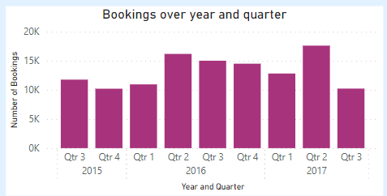
Visualize booking trends over the years, including the number of bookings, cancellations, and average lead time. Identify seasonality patterns.
Quarter 2 of both 2016 and 2017 recorded highest bookings. 2016 recorded highest bookings than any other year. 37% is the cancellation rate.

Slide 9
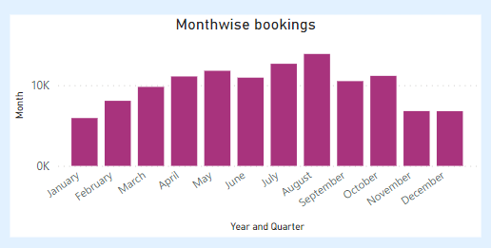
Analyze monthly booking patterns to identify peak months and optimize marketing strategies.
March to October recorded highest number of bookings (>10K) combining all years. Highest number of cancellations (3K) are also in this period.

Slide 10
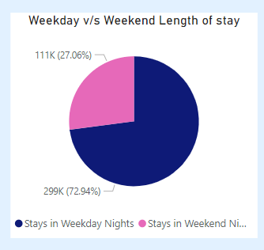
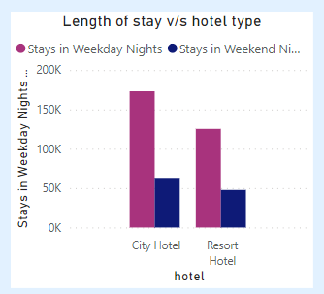
Compare stays in weekend nights and weekday nights to determine preferences and variations by hotel type.
Out of the total length of stay, customers preferred weekdays more. Weekday nights and weekend nights in city hotel is more than that of resort hotel. Total bookings in city hotel more than that of resort hotel.

Slide 11
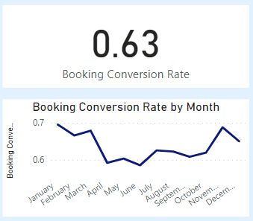
Calculate and visualize the booking conversion rate (canceled bookings to total bookings) over time.
63% of the total bookings were successfully completed, while the remaining 37% resulted in cancellations. From March to October, conversion rate dropped

Slide 12
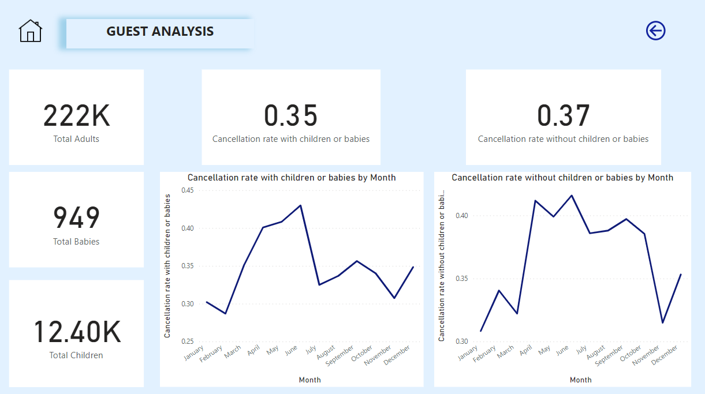

Slide 13
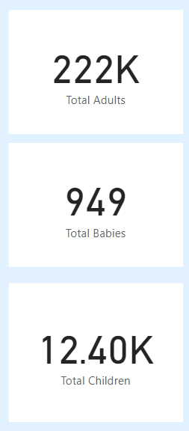
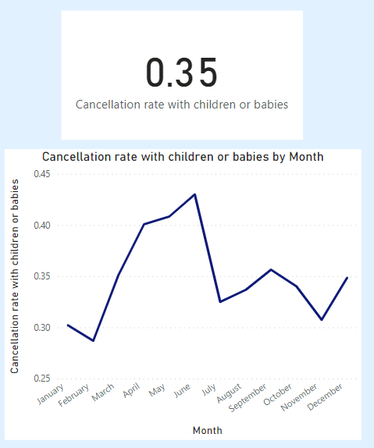
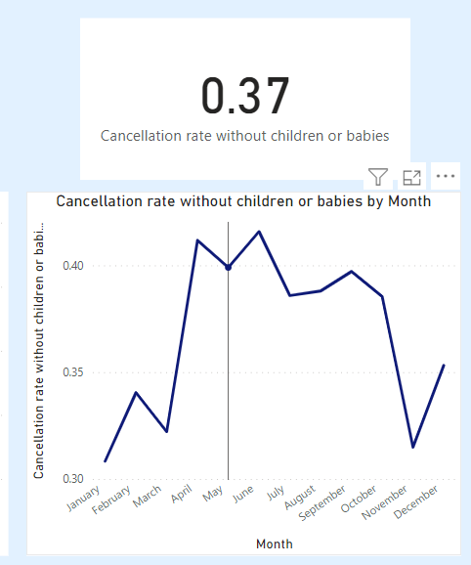
Visualize the distribution of adults, children, and babies in bookings. Explore the impact of children and babies on cancellation rates.
Total adults count greater than babies and children in the bookings. Cancellation rate with children or babies and cancellation rate without children or babies is similar. No impact of children and babies on cancellation rates.

Slide 14
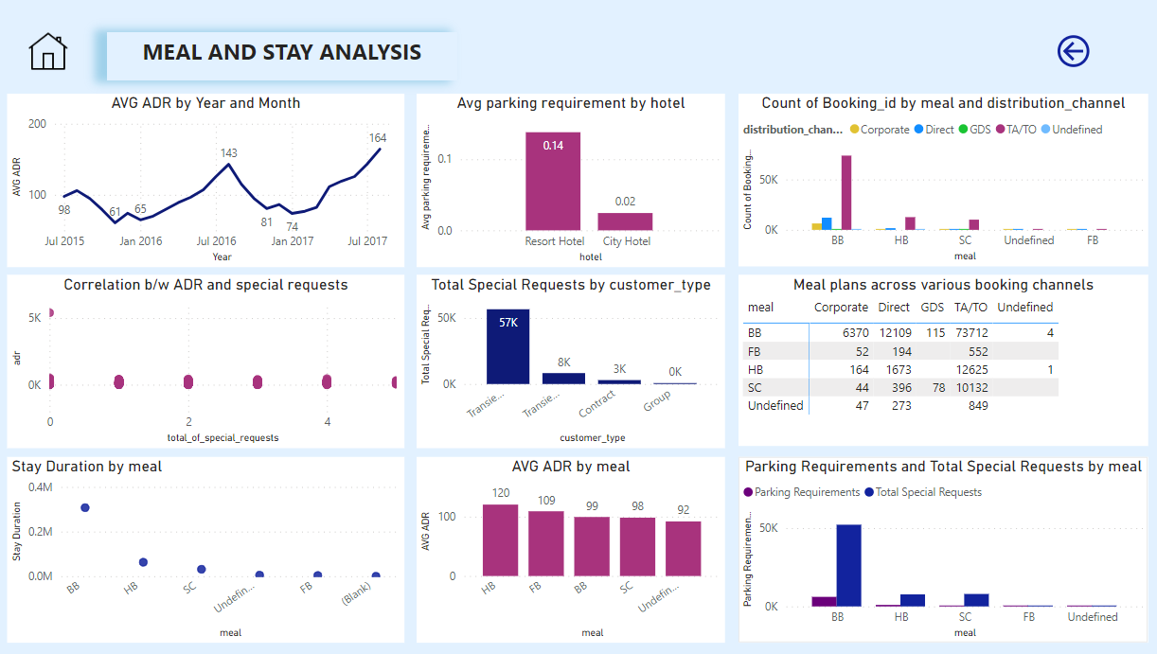

Slide 15
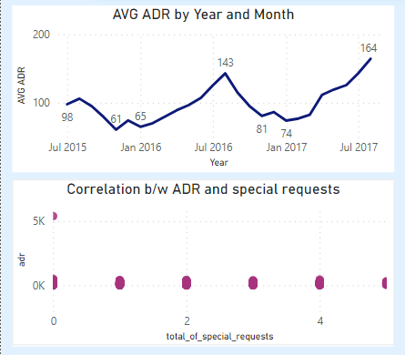
Analyze the distribution of Average Daily Rates (ADR) and identify correlations with the number of special requests made by guests.
2016 August and 2017 August recorded highest ADR. In 2015 November, least ADR recorded. There is no correlation between ADR and special requests.

Slide 16
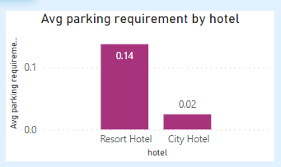
Visualize the relationship between the number of required car parking spaces and booking types (Resort Hotel vs. City Hotel).
Resort hotel parking requirement is 14% whereas city hotel has 2% parking requirement.

Slide 17
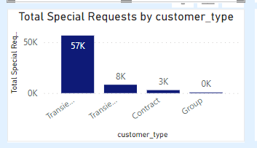
Use Power BI to explore how the total number of special requests made by guests varies by hotel type and customer type (e.g., Transient, Group).
Transient group has raised more special requests.
Groups raised 372 requests.

Slide 18
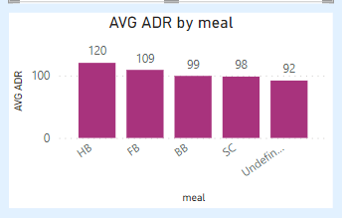
Explore meal plans and their impact on Average Daily Rates (ADR). Analyze meal plan preferences and their association with booking channels.
ADR is highest because of half board

Slide 19
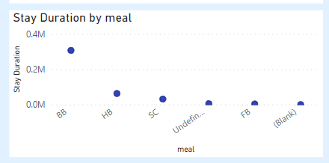
Analyze how meal plans correlate with stay duration and investigate any differences in stay lengths based on meal plans.
Meal plan BB is related with most number of stay duration.

Slide 20
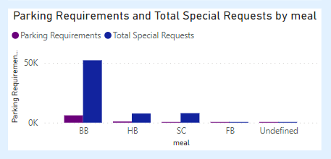
Correlate parking requirements and special requests with different meal plans. Determine if certain meal plans result in more requests or parking needs.
Most number of special requests have come from people who preferred BB meal plan

Slide 21
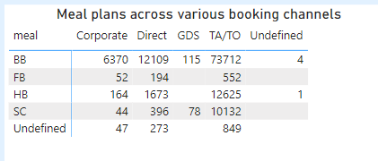
Explore how meal plans are distributed across various booking channels. Analyze if certain channels are associated with specific meal plans.
For all booking channels, the most preferred meal plan is BB, the least preferred is SC. Some customers do not have a finite meal plan

Slide 22
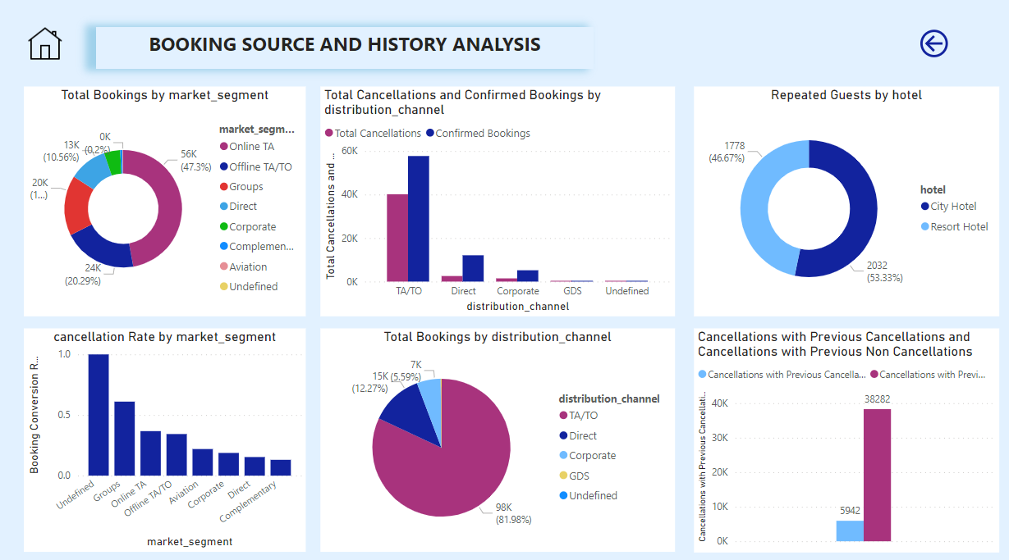

Slide 23
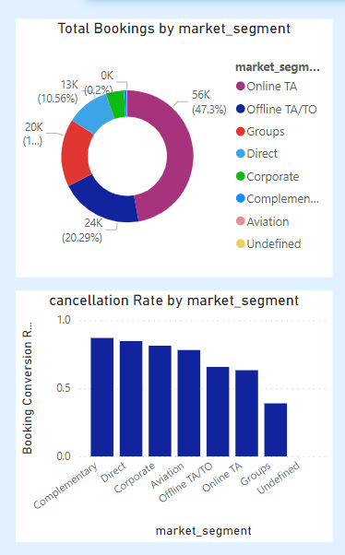
Visualize booking distribution across different market segments and analyze cancellation rates within each segment.
Online TA has highest bookings but cancellation rate is highest for complementary market segment.

Slide 24
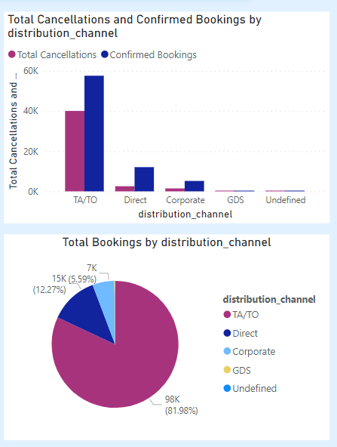
Compare the effectiveness of booking distribution channels in generating confirmed bookings. Identify the most commonly used channels by guests.
Total confirmed bookings is greater in TA/TO distribution channel. TA?TO has the highest booking as well

Slide 25
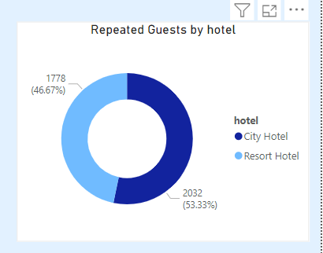
Visualize the percentage of repeated guests for each hotel type (Resort Hotel vs. City Hotel) over time. Explore factors influencing guest retention.
Repeated guests percentage is more in city hotel. Special requests and car parking facilities are the main reasons of guest retention

Slide 26
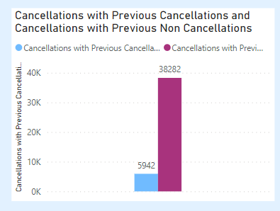
Analyze the impact of a guest's booking history (previous cancellations and non canceled bookings) on their likelihood of canceling a current booking.
Out of all cancellations, present cancellations with previous cancellations is low compared to the other

Slide 27
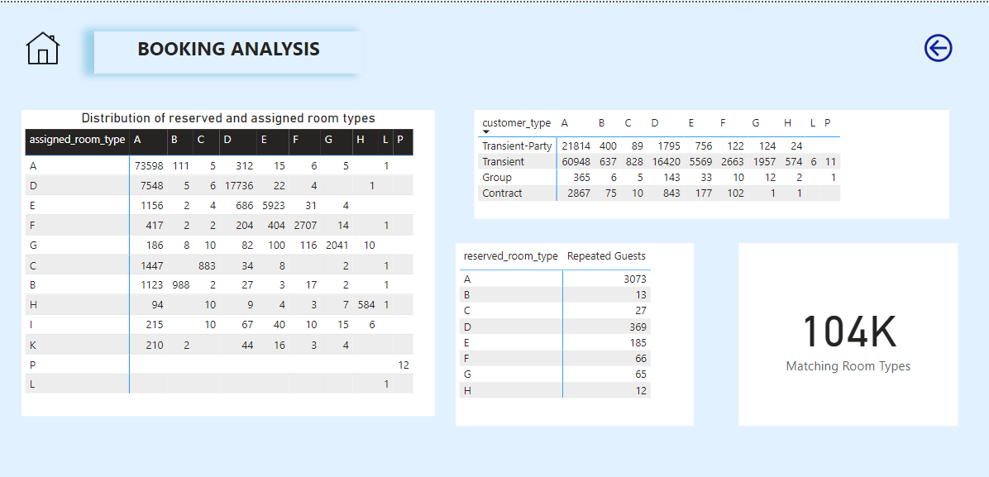

Slide 28
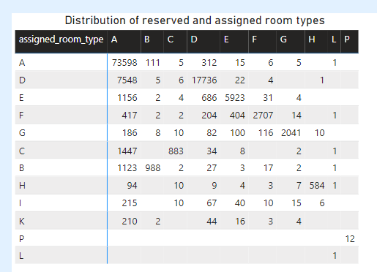
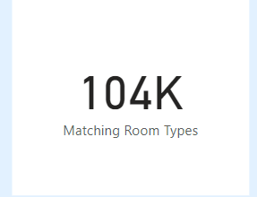
Visualize the distribution of reserved and assigned room types. Analyze whether guests tend to receive the room type they initially reserved.
104K bookings got the same room they preferred. Most customers preferred room type A

Slide 29
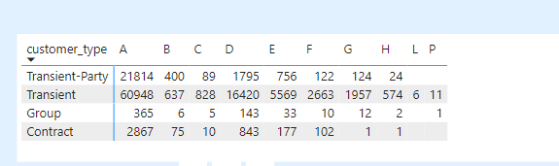
Analyze room type preferences based on customer types (e.g., Transient, Group) and identify any patterns in room type selection.
All customer types preferred room A.

Slide 30
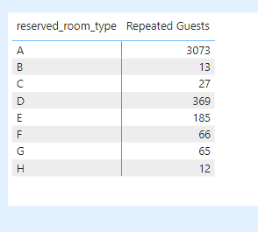
Analyze whether guests who make multiple bookings tend to consistently request the same room type or if their preferences change over time.
Repeated guests more prefer room type A

Slide 31
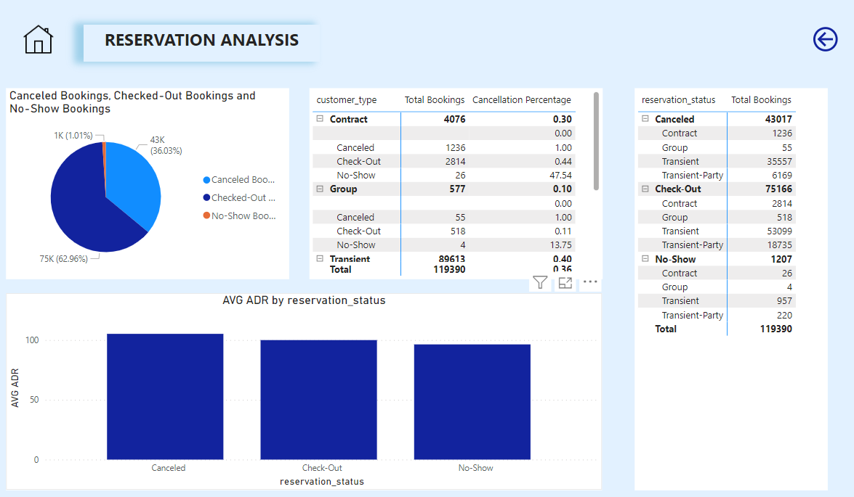

Slide 32
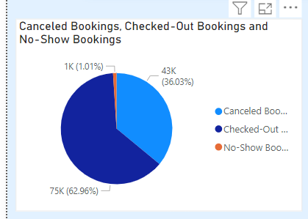
Provide an overview of reservation statuses over time, including the percentage of canceled, checked out, and no show bookings.
Checked out percentage is more.

Slide 33
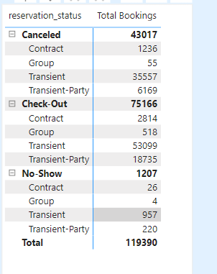
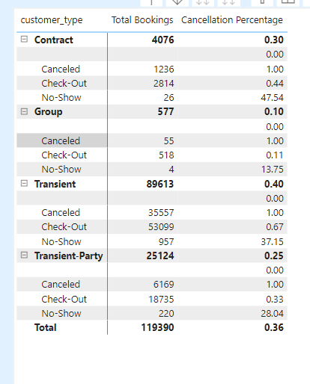
Visualize how reservation statuses vary across different customer types (e.g., Transient, Group) and identify if certain customer types are more likely to result in cancellations or noshows.
Transient has more cancellation rate and more bookings

Slide 34
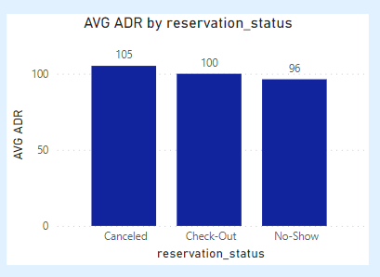
Explore the relationship between reservation statuses and Average Daily Rates (ADR) to determine if there are differences in ADR based on booking outcomes.
ADR does not vary much with respect to reservation statuses. Canceled has more ADR.

Slide 35
EDA PROBLEM STATEMENTS

Slide 36
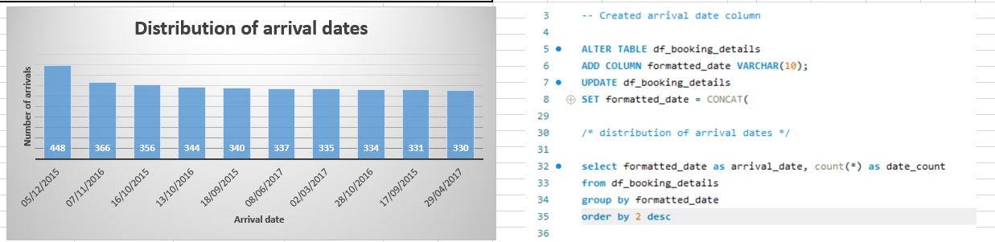
Understand the distribution of arrival dates, including the most common arrival days and summary statistics for lead times.
Peak Booking Days:
December 5, 2015, has the highest count of bookings (448), indicating it was a peak day for hotel reservations.
November 7, 2016, and October 16, 2015, also have substantial booking counts, suggesting these dates might correspond to popular travel periods.
2017 July has more lead time

Slide 37
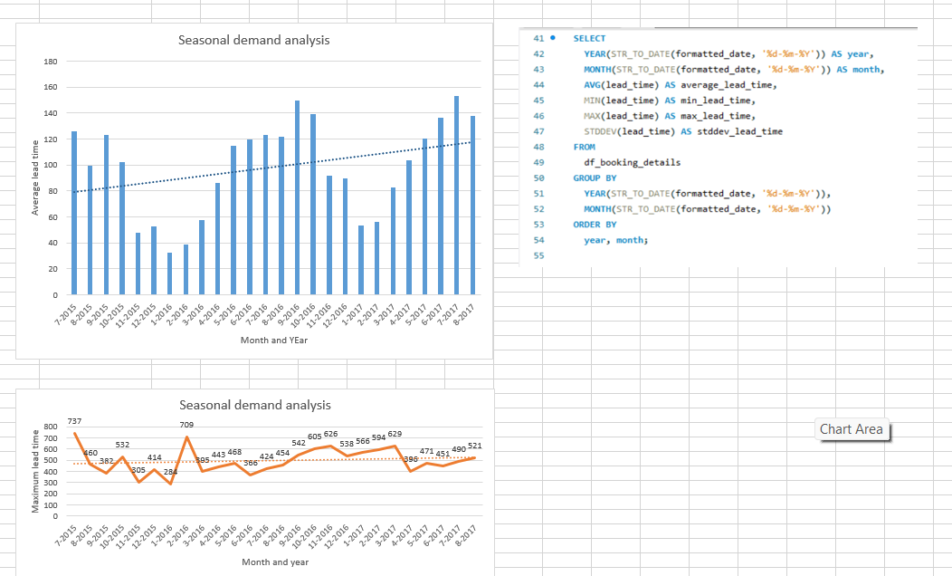
Identify peak booking months and analyze reasons for spikes in bookings, including holidays or events.
Sep 2016 and July 2017 – peak booking months

Slide 38
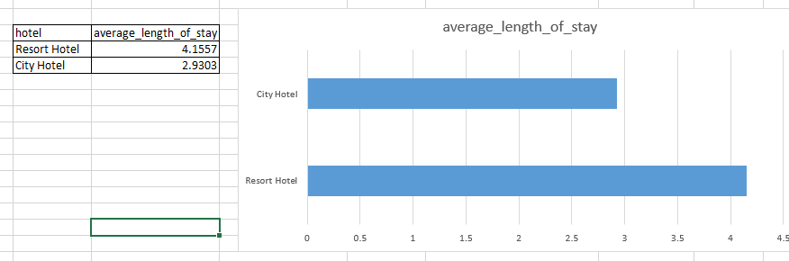
Calculate the average length of stays for different hotel types and explore variations by meal plans.
Average length of stay more in resort hotel

Slide 39
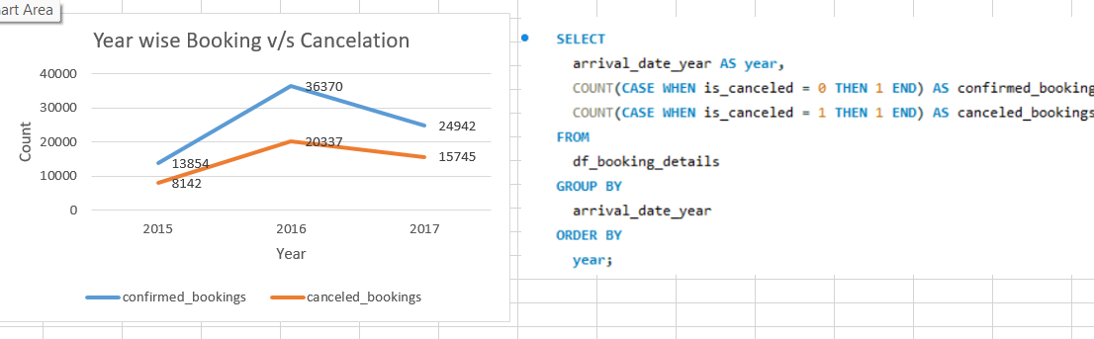
Analyze how booking patterns have evolved over the years, including year over year changes in bookings and cancellations.
Bookings increased in 2016 then see a decline

Slide 40
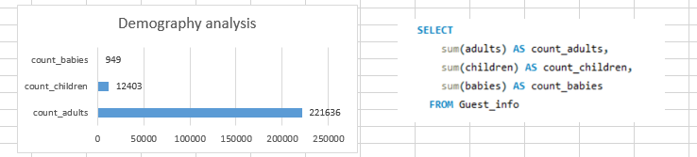
Understand the distribution of the number of adults, children, and babies and identify any outliers.
Adults > Children > Babies

Slide 41
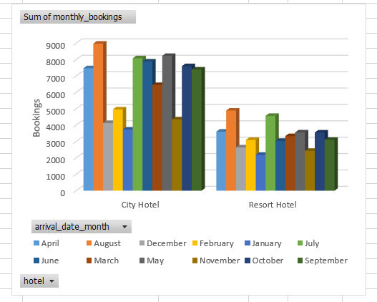
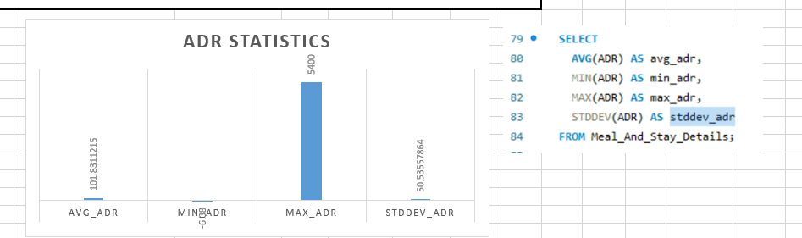
Calculate summary statistics for ADR and explore differences between Resort Hotel and City Hotel bookings.
Max ADR is 5400

Slide 42
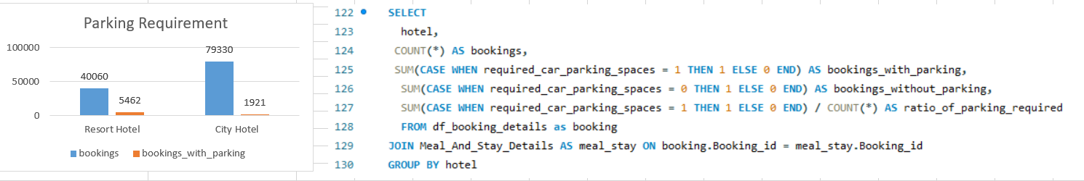
Analyze the distribution of required car parking spaces for each hotel type and determine if one type attracts more guests with cars.
City hotel has more parking requirement and repeated customers are also more in city hotel

Slide 43
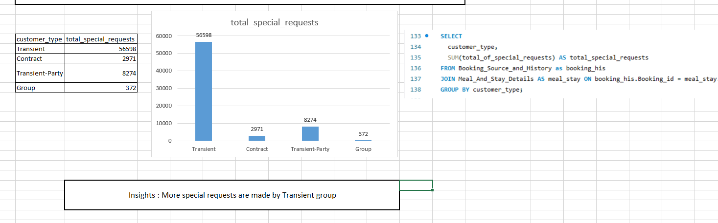
Compare the total number of special requests made by different customer types (e.g., Transient, Group) and identify which customer type makes more requests.

Slide 44
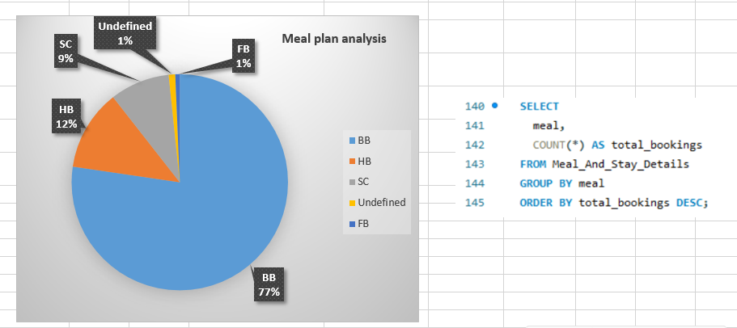
Understand the distribution of meal plans (e.g., BB, HB, FB, SC) and identify any patterns or preferences.
Most preferred meal plan is BB

Slide 45
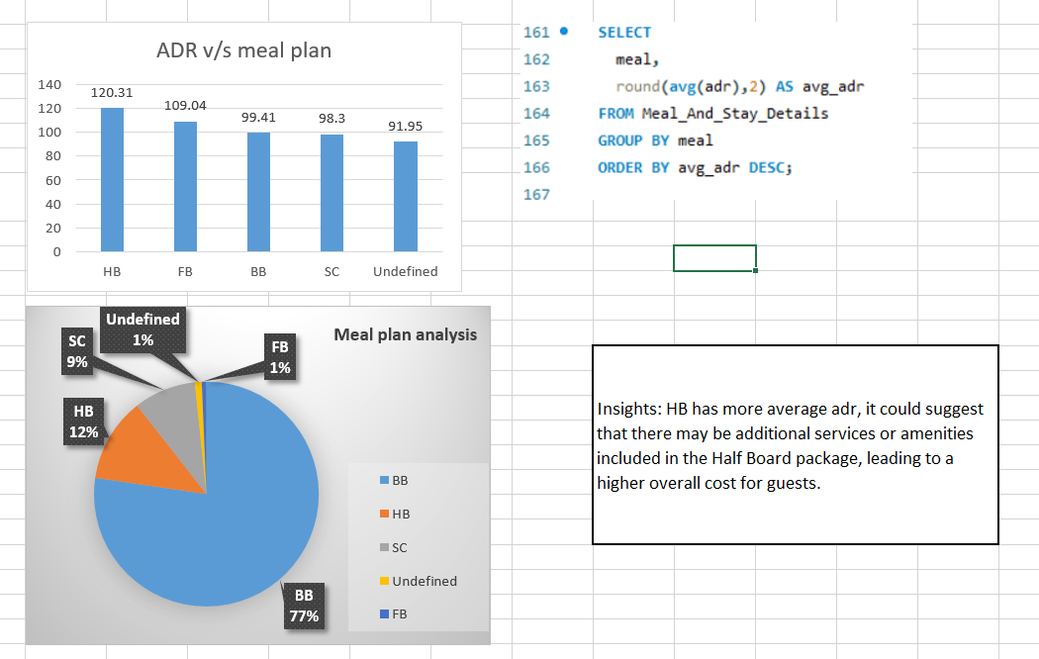
Analyze Average Daily Rates (ADR) by meal plan type to identify variations in pricing.

Slide 46
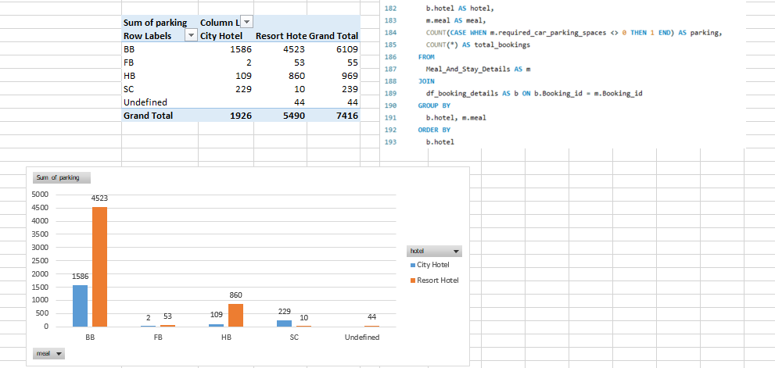
Investigate the distribution of required car parking spaces and special requests by hotel type and meal plan..
Customers who preferred BB meal plan has requested more car parking spaces

Slide 47
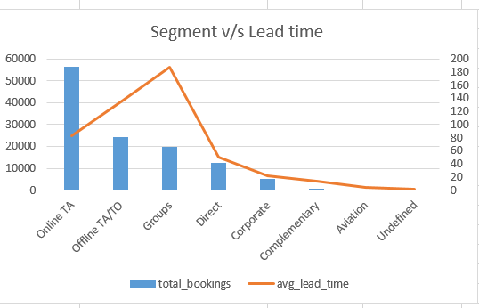
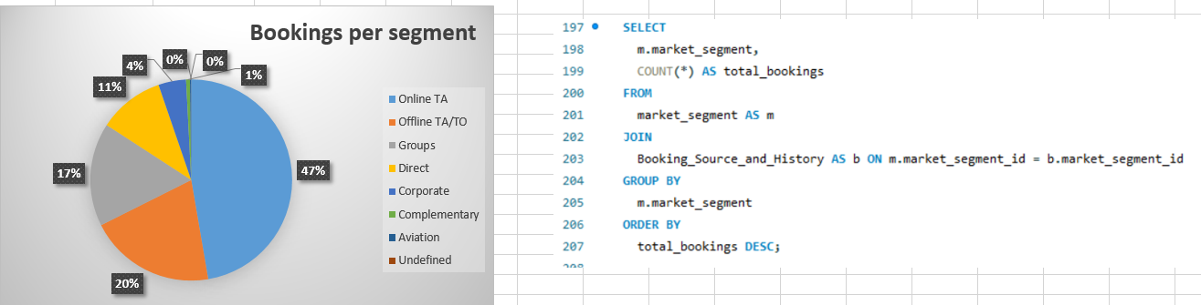
Understand the distribution of bookings across different market segments and calculate summary statistics for lead times within each segment.
Online TA has highest number of bookings and lead time is high for offline TA/TO and Groups

Slide 48

Analyze the distribution of bookings through different booking channels (e.g., online travel agents, direct bookings) and calculate the percentage of bookings through each channel.
TA/To is the most preferred channel

Slide 49

Calculate the proportion of repeated guests and investigate their booking behavior. Identify any patterns or differences in preferences compared to first time guests.
First time guest and repeated guest preferred BB, 3% of bookings done by repeated guests

Slide 50


Explore the impact of a guest's booking history on their likelihood of canceling a current booking. Calculate cancellation rates based on previous cancellations and non canceled bookings.
91% chance that customers with previous cancellations have canceled the bookings

Slide 51


Understand the distribution of reserved and assigned room types. Calculate summary statistics for the consistency between reserved and assigned room types.

Slide 52

Analyze the impact of booking changes on cancellation rates. Calculate cancellation rates for bookings with different numbers of changes.
O booking changes have more cancellation rate.

Slide 53

Explore how room type preferences vary across different customer types (e.g., Transient, Group). Identify if certain customer types have specific room preferences.
All customer types mostly prefer A room type

Slide 54


Examine whether guests who make multiple bookings have consistent room type preferences or if their preferences change over time.
Most repeated guests prefer room type A

Slide 55

Understand the distribution of reservation statuses and calculate summary statistics for reservation status dates.
Check out > Cancelled > No-show

Slide 56

Explore how reservation statuses vary across different customer types (e.g., Transient, Group) using Excel or SQL. Calculate cancellation rates by customer type.
Cancellation rate is more for transient customer type

Slide 57

Investigate whether there are differences in Average Daily Rates (ADR) based on reservation status (e.g., canceled vs. checkedout).
There are only slight differences between ADR rates of different reservation statuses

